Slide 1


Project #1
- Blackjack Game
Erik Carlstedt
Oscar Lidheim

Slide 2



Agenda
Game Description (Demo)
Challenges
Lessons learned
Features to add

Slide 3
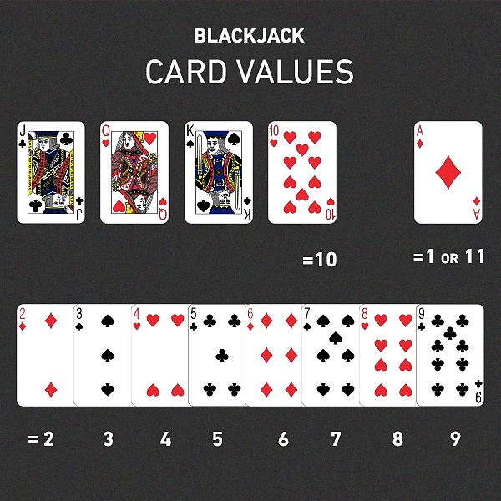
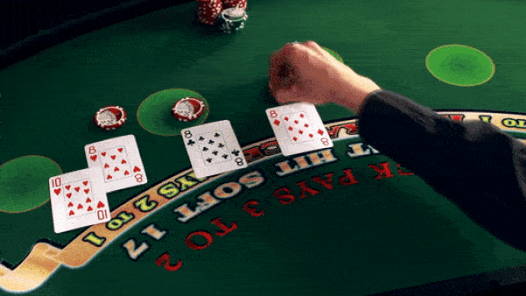
Classic Casino Game

Slide 4



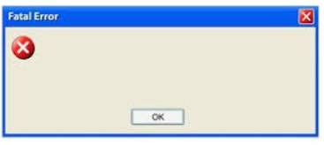
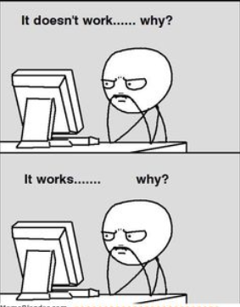
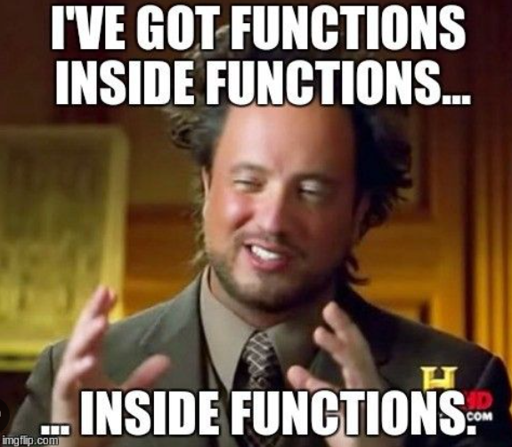
Challenges
PLANNING AND NEW FEATURES
FIXING BUGS – PROBLEM?!
Testing was inefficient
EXPLAINING CODE/PLAN
TO TEAM MEMBER

Slide 5
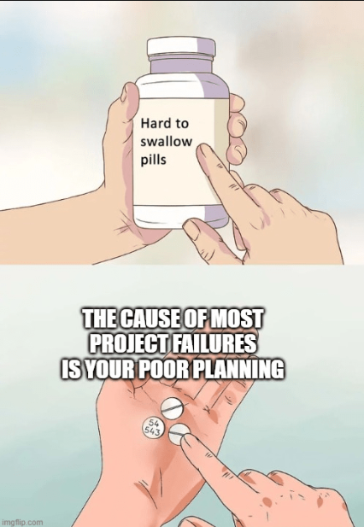
Lessons Learned
Plan Major Features in Advance
When adding split function, it changed almost all other functions
Repeating same code in game logic (not optimal)
Use more functions inside game logic, to make code more readable (use Trello board more)
Game Logic is way too long and not readable
Understand the bug when you fix it
Sometimes easy to fix but hard to find why it was an issue
clear_output + time_sleep(0.5)

Slide 6
Features to add
Starting Stack and Betting
Gambling!
Splits on splits
Repeating code again!
Better Visuals
Blackjack table and actual playing cards

Slide 7


Thank You

